Slide 1














WeCanDraw
Topic: DrawVoice Meeting
Huỳnh Trần Khanh - ITCSIU21011
Hồ Tiến Đạt - ITCSIU21047
Bùi Phương Thanh - ITITIU21311

Slide 2
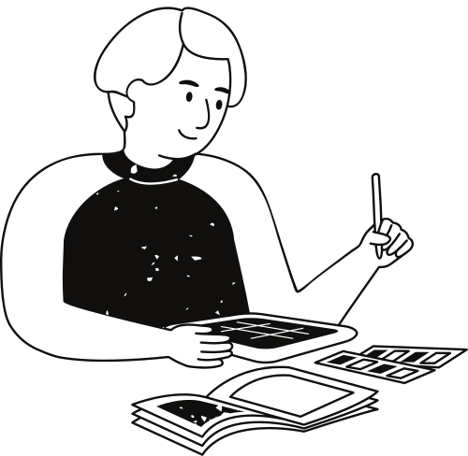
Introduction

Slide 3
Introduction
Communication platforms have become essential tools.
More people are seeking efficient ways to connect and engage online.

Slide 4
Introduction
Draw and Voice Chat Web Application
-Engage in real-time drawing, and voice chat.
-Easily collaborate and share ideas.
-Login System. Create room chat, Join room chat, Drawboard and Voice chat.

Slide 5
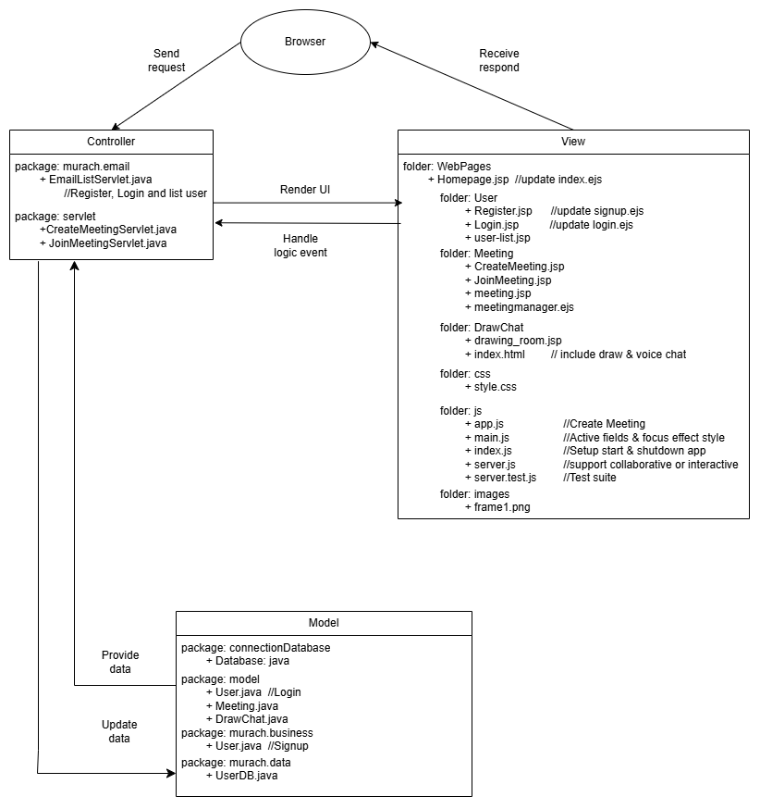
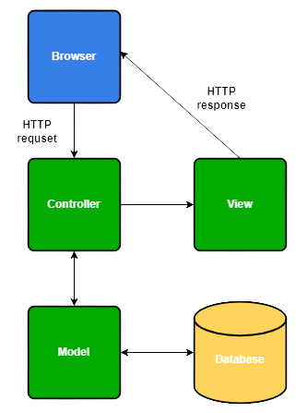
MVC model

Slide 6
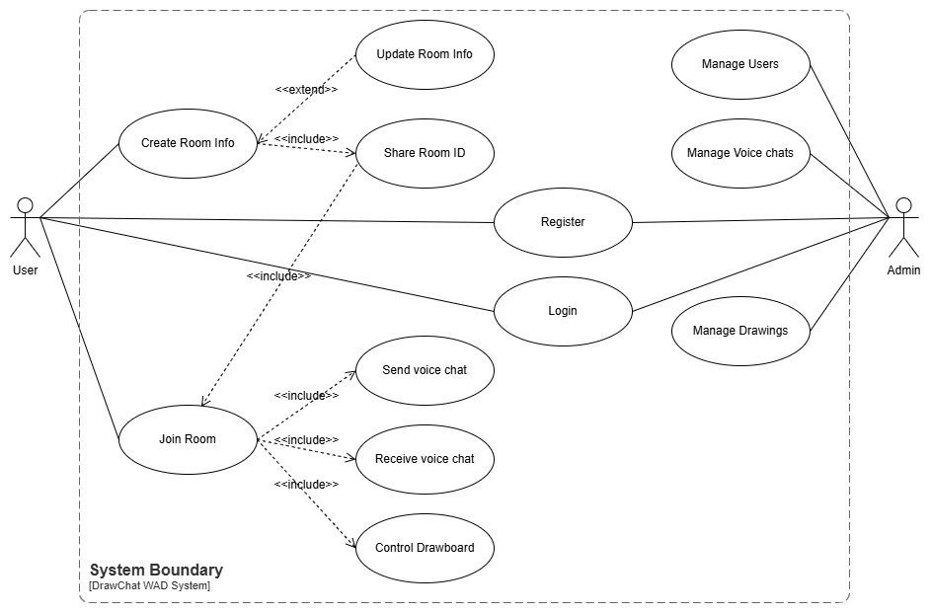
Use case diagram

Slide 7
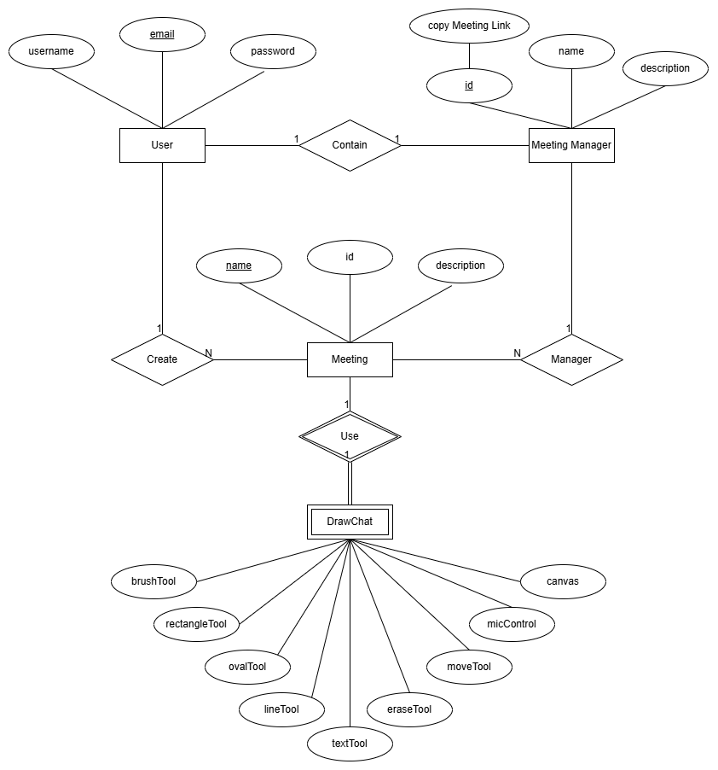
Entity Relationship
Diagram

Slide 8
Purpose
Live meetings with a collaborative whiteboard and voice chat

Slide 9
Frontend: HTML, CSS, JS
01.
Technologies
Backend: Node.js, Java Servlet
02.
MySQL, SQLite, Jitsi Meet
03.

Slide 10
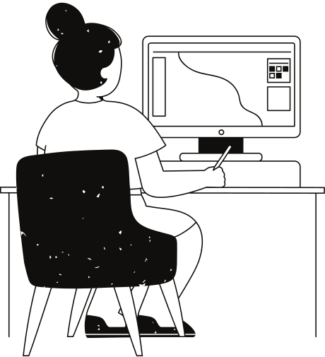
Security
Passwords are hashed with PBKDF2 on client side and SHA-256 on server side.
Cookies are authenticated with HMAC and SameSite is set to Strict to prevent CSRF.

Slide 11
Flow
01
02
03
04
User signs up and logs in
User creates a meeting link
User shares the meeting link with others
User and their friends can meet together

Slide 12
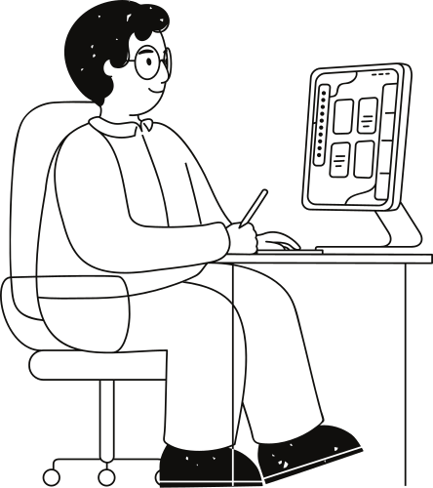
Meeting data
Stored as a log of binary data in the database
The server does not interpret the data, only the client does
The server's sole job is to store and relay data to other clients

Slide 13
Inter-server communication
The application consists of multiple servers running in both Node.js and Java. To bridge between the two languages, we use HTTP redirects and tokens.

Slide 14
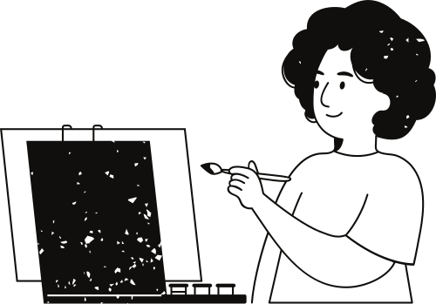
Demo
https://abundant-rambunctious-apple.glitch.me/

Slide 15
Thank you very much!

